Slide 1
Abstract Data Types (ADTs)
An abstract data type (ADT) is an abstraction of a data structure
An ADT specifies:
  Data stored
  Operations on the data
  Error conditions associated with operations
‹#›
Notes:
‹#›

Slide 2

The Stack ADT
push
pop
top
‹#›
Notes:
‹#›

Slide 3
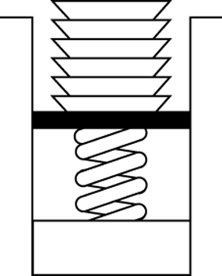
The Stack ADT
The Stack ADT stores arbitrary objects.
Insertions and deletions follow the last-in
first-out (LIFO) scheme.
  The last item placed on the stack will
  be the first item removed.
  (similar to a stack of dishes)
Stack of Dishes
‹#›
Notes:
‹#›

Slide 4
ADT Stack Operations
Create an empty stack
Destroy a stack
Determine whether a stack is empty
Add a new item -- push
Remove the item that was added most recently -- pop
Retrieve the item that was added most recently
push
pop
top
Stack
‹#›
Notes:
‹#›

Slide 5
ADT Stack Operations(cont.)
Stack()
  creates a an empty stack
~Stack()
  destroys a stack
isEmpty():boolean
  determines whether a stack is empty or not
push(in newItem:StackItemType)
  Adds newItem to the top of a stack
pop() throw StackException
topAndPop(out stackTop:StackItemType)
  Removes the top of a stack (ie. removes the item that was added most recently
getTop(out stackTop:StackItemType)
  Retrieves the top of stack into stackTop
‹#›
Notes:
‹#›

Slide 6
Implementations of the ADT Stack
The ADT stack can be implemented using
  An array
  A linked list
  The ADT list (linked list of the previous lecture)
All three implementations use a StackException class to handle possible exceptions
class StackException {
public:
StackException(const string& err) : error(err) {}
string error;
};
‹#›
Notes:
‹#›

Slide 7
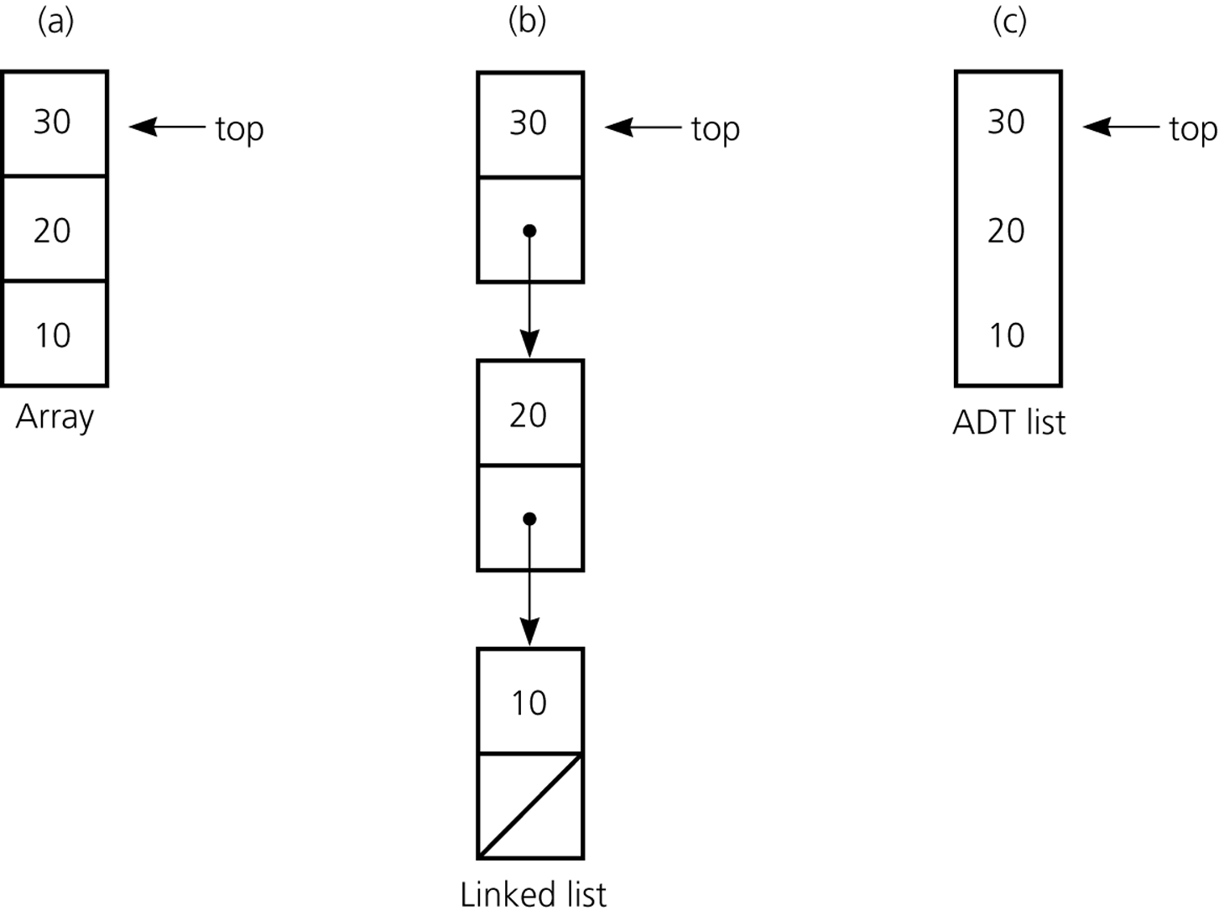
Implementations of the ADT Stack (cont.)
2
1
0
(reuse existing List.h)
(pointer-based)
‹#›
Notes:
‹#›

Slide 8
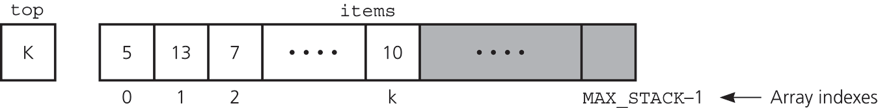
An Array-Based Implementation of the ADT Stack
Private data fields
  An array of items of type StackItemType
  The index top
Compiler-generated destructor, copy constructor, and assignment operator
‹#›
Notes:
‹#›

Slide 9
An Array-Based Implementation –Header File
#include "StackException.h"
const int MAX_STACK = maximum-size-of-stack;
template <class T>
class Stack {
public:
Stack(); // default constructor; copy constructor and destructor are supplied by the compiler
// stack operations:
bool isEmpty() const; // Determines whether a stack is empty.
void push(const T& newItem); // Adds an item to the top of a stack.
void pop(); // Removes the top of a stack.
void topAndPop(T& stackTop);
void getTop(T& stackTop) const; // Retrieves top of stack.
private:
T items[MAX_STACK]; // array of stack items
int top; // index to top of stack
};
‹#›
Notes:
‹#›

Slide 10
An Array-Based Implementation
template <class T>
Stack<T>::Stack(): top(-1) {} // default constructor
template <class T>
bool Stack<T>::isEmpty() const {
return top < 0;
}
‹#›
Notes:
‹#›

Slide 11
An Array-Based Implementation
template <class T>
void Stack<T>::push(const T& newItem) {
if (top >= MAX_STACK-1)
throw StackException("StackException: stack full on push");
else
items[++top] = newItem;
}
‹#›
Notes:
‹#›

Slide 12
An Array-Based Implementation – pop
template <class T>
void Stack<T>::pop() {
if (isEmpty())
throw StackException("StackException: stack empty on pop");
else
--top; // stack is not empty; pop top
}
‹#›
Notes:
‹#›

Slide 13
An Array-Based Implementation – pop
template <class T>
void Stack<T>::topAndPop(T& stackTop) {
if (isEmpty())
throw StackException("StackException: stack empty on pop");
else // stack is not empty; retrieve top
stackTop = items[top--];
}
‹#›
Notes:
‹#›

Slide 14
An Array-Based Implementation – getTop
template <class T>
void Stack<T>::getTop(T& stackTop) const {
if (isEmpty())
throw StackException("StackException: stack empty on getTop");
else
stackTop = items[top];
}
‹#›
Notes:
‹#›

Slide 15
An Array-Based Implementation
Disadvantages of the array based implementation is similar the disadvantages of arrays
Furthermore, it forces all stack objects to have MAX_STACK elements
We can fix this limitation by using a pointer instead of an array
template <class T>
class Stack {
public:
Stack(int size) : items(new T [size]) { };
... // other parts not shown
private:
T* items; // pointer to the stack elements
int top; // index to top of stack
};
“Need to implement copy constructor, destructor and assignment operator in this case”
‹#›
Notes:
‹#›

Slide 16
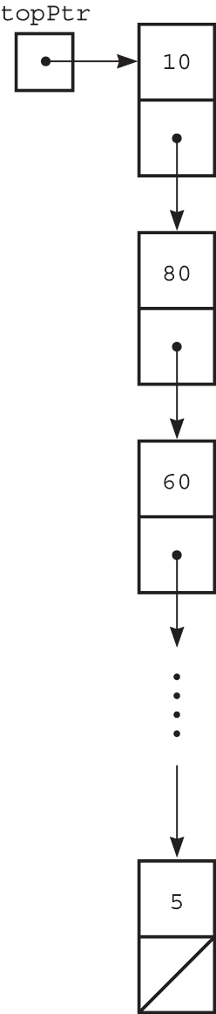
A Pointer-Based Implementation of the ADT Stack
A pointer-based implementation
  Required when the stack needs to grow and shrink dynamically
  Very similar to linked lists
top is a reference to the head of a linked list of items
A copy constructor, assignment operator, and destructor must be supplied
‹#›
Notes:
‹#›

Slide 17
A Pointer-Based Implementation – Header File
template <class Object>
class StackNode
{
public:
StackNode(const Object& e = Object(), StackNode* n = NULL)
: element(e), next(n) {}
Object item;
StackNode* next;
};
‹#›
Notes:
‹#›

Slide 18
A Pointer-Based Implementation – Header File
#include "StackException.h"
template <class T>
class Stack{
public:
Stack(); // default constructor
Stack(const Stack& rhs); // copy constructor
~Stack(); // destructor
Stack& operator=(const Stack& rhs); // assignment operator
bool isEmpty() const;
void push(const T& newItem);
void pop();
void topAndPop(T& stackTop);
void getTop(T& stackTop) const;
private:
StackNode<T> *topPtr; // pointer to the first node in the stack
};
‹#›
Notes:
‹#›

Slide 19
A Pointer-Based Implementation – constructor and isEmpty
template <class T>
Stack<T>::Stack() : topPtr(NULL) {} // default constructor
template <class T>
bool Stack<T>::isEmpty() const
{
return topPtr == NULL;
}
‹#›
Notes:
‹#›

Slide 20
A Pointer-Based Implementation – push
template <class T>
void Stack<T>::push(const T& newItem) {
// create a new node
StackNode *newPtr = new StackNode;
newPtr->item = newItem; // insert the data
newPtr->next = topPtr; // link this node to the stack
topPtr = newPtr; // update the stack top
}
‹#›
Notes:
‹#›

Slide 21
A Pointer-Based Implementation – pop
template <class T>
void Stack<T>::pop() {
if (isEmpty())
throw StackException("StackException: stack empty on pop");
else {
StackNode<T> *tmp = topPtr;
topPtr = topPtr->next; // update the stack top
delete tmp;
}
}
‹#›
Notes:
‹#›

Slide 22
A Pointer-Based Implementation – topAndPop
template <class T>
void Stack<T>::topAndPop(T& stackTop) {
if (isEmpty())
throw StackException("StackException: stack empty on topAndPop");
else {
stackTop = topPtr->item;
StackNode<T> *tmp = topPtr;
topPtr = topPtr->next; // update the stack top
delete tmp;
}
}
‹#›
Notes:
‹#›

Slide 23
A Pointer-Based Implementation – getTop
template <class T>
void Stack<T>::getTop(T& stackTop) const {
if (isEmpty())
throw StackException("StackException: stack empty on getTop");
else
stackTop = topPtr->item;
}
‹#›
Notes:
‹#›

Slide 24
A Pointer-Based Implementation –
destructor
template <class T>
Stack<T>::~Stack() {
// pop until stack is empty
while (!isEmpty())
pop();
}
‹#›
Notes:
‹#›

Slide 25
A Pointer-Based Implementation – assignment
template <class T>
Stack<T>& Stack<T>::operator=(const Stack& rhs) {
if (this != &rhs) {
if (!rhs.topPtr)
topPtr = NULL;
else {
topPtr = new StackNode<T>;
topPtr->item = rhs.topPtr->item;
StackNode<T>* q = rhs.topPtr->next;
StackNode<T>* p = topPtr;
while (q) {
p->next = new StackNode<T>;
p->next->item = q->item;
p = p->next;
q = q->next;
}
p->next = NULL;
}
}
return *this;
}
‹#›
Notes:
‹#›

Slide 26
A Pointer-Based Implementation – copy constructor
template <class T>
Stack<T>::Stack(const Stack& rhs) {
*this = rhs; // reuse assignment operator
}
‹#›
Notes:
‹#›

Slide 27
Testing the Stack Class
int main() {
Stack<int> s;
for (int i = 0; i < 10; i++)
s.push(i);
Stack<int> s2 = s; // test copy constructor (also tests assignment)
std::cout << "Printing s:" << std::endl;
while (!s.isEmpty()) {
int value;
s.topAndPop(value);
std::cout << value << std::endl;
}
‹#›
Notes:
‹#›

Slide 28
Testing the Stack Class
std::cout << "Printing s2:" << std::endl;
while (!s2.isEmpty()) {
int value;
s2.topAndPop(value);
std::cout << value << std::endl;
}
return 0;
}
‹#›
Notes:
‹#›

Slide 29
An Implementation That Uses the ADT List
#include "StackException.h"
#include "List.h"
template <class T>
class Stack{
public:
bool isEmpty() const;
void push(const T& newItem);
void pop();
void topAndPop(T& stackTop);
void getTop(T& stackTop) const;
private:
List<T> list;
}
‹#›
Notes:
‹#›

Slide 30
An Implementation That Uses the ADT List
No need to implement constructor, copy constructor, destructor, and assignment operator
  The list's functions will be called when needed
isEmpty(): return list.isEmpty()
push(x): list.insert(x, list.zeroth())
pop(): list.remove(list.first()->element)
topAndPop(&x) and getTop(&x) are similar
‹#›
Notes:
‹#›

Slide 31
Comparing Implementations
Array based:
  Fixed size (cannot grow and shrink dynamically)
Using a single pointer:
  May need to perform realloc calls when the currently allocated size is exceeded //Recall the line Stack(int size) : items(new T [size]) { };
  But push and pop operations can be very fast
Using a customized linked-list:
  The size can match perfectly to the contained data
  Push and pop can be a bit slower than above
Using the previously defined linked-list:
  Reuses existing implementation
  Reduces the coding effort but may be a bit less efficient
‹#›
Notes:
‹#›

Slide 32
A Simple Stack Application --
Undo sequence in a text editor
Problem: abcd← ←fg ← 🡺 abf
// Reads an input line. Enter a character or a backspace character (←)
readAndCorrect(out aStack:Stack) {
?????????????????????????????
}
‹#›
Notes:
‹#›

Slide 33
A Simple Stack Application --
Undo sequence in a text editor
Problem: abcd← ←fg ← 🡺 abf
// Reads an input line. Enter a character or a backspace character (←)
readAndCorrect(out aStack:Stack) {
aStack.createStack()
read newChar
while (newChar is not end-of-line symbol) {
if (newChar is not backspace character)
aStack.push(newChar)
else if (!aStack.isEmpty())
aStack.pop()
read newChar
}
}
‹#›
Notes:
‹#›

Slide 34
A Simple Stack Application -- Display Backward
Display the input line in reversed order by writing the contents of stack aStack.
displayBackward(in aStack:Stack) {
?????????
}
‹#›
Notes:
‹#›

Slide 35
A Simple Stack Application -- Display Backward
Display the input line in reversed order by writing the contents of stack aStack.
displayBackward(in aStack:Stack) {
while (!aStack.isEmpty())) {
aStack.pop(newChar)
print newChar
}
}
‹#›
Notes:
‹#›

Slide 36
Checking for Balanced Braces
A stack can be used to verify whether a program contains balanced braces
An example of balanced braces
abc{defg{ijk}{l{mn}}op}qr
An example of unbalanced braces
abc{def}}{ghij{kl}m
Requirements for balanced braces
  Each time we encounter a “}”, it matches an already encountered “{”
  When we reach the end of the string, we have matched each “{”
‹#›
Notes:
‹#›

Slide 37
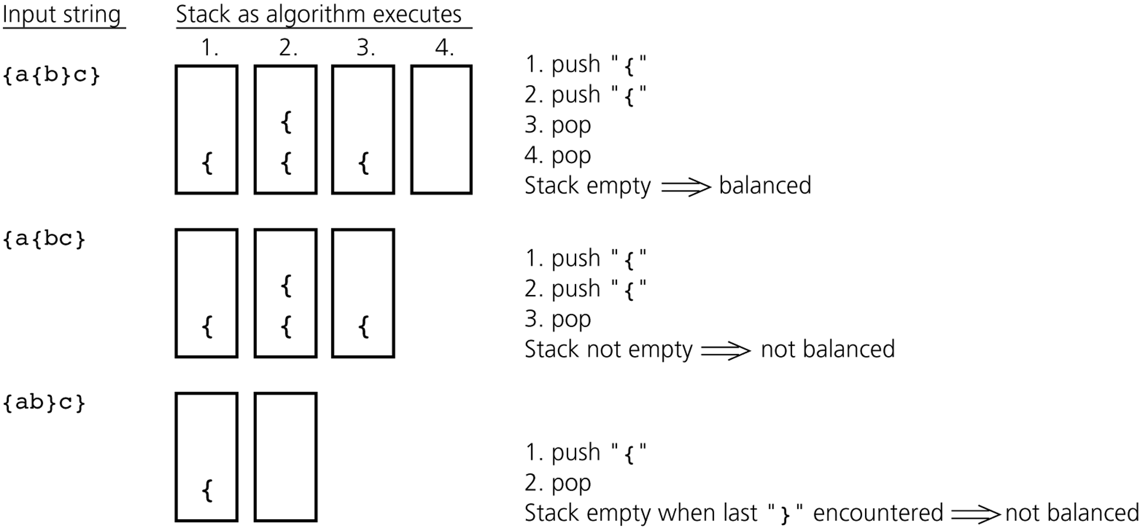
Checking for Balanced Braces -- Traces
‹#›
Notes:
‹#›

Slide 38
Checking for Balanced Braces -- Algorithm
aStack.createStack(); balancedSoFar = true; i=0;
while (balancedSoFar and i < length of aString) {
ch = character at position i in aString; i++;
if (ch is ‘{‘) // push an open brace
aStack.push(‘{‘);
else if (ch is ‘}’) // close brace
if (!aStack.isEmpty())
aStack.pop(); // pop a matching open brace
else // no matching open brace
balancedSoFar = false;
// ignore all characters other than braces
}
if (balancedSoFar and aStack.isEmpty())
aString has balanced braces
else
aString does not have balanced braces
‹#›
Notes:
‹#›

Slide 39
Recognizing Strings in a Language
L = {w$w’ : w is a (possible empty) string of characters other than $,
w’ = reverse(w) }
  abc$cba, a$a, $, abc$abc, a$b, a$ are in or out the language L?
‹#›
Notes:
‹#›

Slide 40
Recognizing Strings in a Language
L = {w$w’ : w is a (possible empty) string of characters other than $,
w’ = reverse(w) }
  abc$cba, a$a, $ are in the language L
  abc$abc, a$b, a$ are not in the language L
Problem: Deciding whether a given string in the language L or not.
A solution using a stack
  ??
  ??
‹#›
Notes:
‹#›

Slide 41
Recognizing Strings in a Language
L = {w$w’ : w is a (possible empty) string of characters other than $,
w’ = reverse(w) }
  abc$cba, a$a, $ are in the language L
  abc$abc, a$b, a$ are not in the language L
Problem: Deciding whether a given string in the language L or not.
A solution using a stack
  Traverse the first half of the string, pushing each char onto a stack
  Once you reach the $, for each character in the second half of the string, match a popped character off the stack
‹#›
Notes:
‹#›

Slide 42
Recognizing Strings in a Language -- Algorithm
aStack.createStack(); i=0; ch = character at position i in aString;
while (ch is not ‘$’) { // push the characters before $ (w) onto the stack
aStack.push(ch); i++; ch = character at position i in aString;
}
i++; inLanguage = true; // skip $; assume string in language
while (inLanguage and i <length of aString) // match the reverse of
if (aStack.isEmpty()) inLanguage = false; // first part shorter than second part
else {
aStack.pop(stackTop); ch = character at position i in aString;
if (stackTop equals to ch) i++; // characters match
else inLanguage = false; // characters do not match
}
if (inLanguage and aStack.isEmpty())
aString is in language
else
aString is not in language
‹#›
Notes:
‹#›

Slide 43
Application: Algebraic Expressions
When the ADT stack is used to solve a problem, the use of the ADT’s operations should not depend on its implementation
To evaluate an infix expression //infix: operator in b/w operands
  Convert the infix expression to postfix form
  Evaluate the postfix expression //postfix: operator after operands; similarly we have prefix: operator before operands
Infix Expression Postfix Expression Prefix Expression
5 + 2 * 3
5 * 2 + 3
5 * ( 2 + 3 ) - 4
‹#›
Notes:
‹#›

Slide 44
Application: Algebraic Expressions
When the ADT stack is used to solve a problem, the use of the ADT’s operations should not depend on its implementation
To evaluate an infix expression //infix: operator in b/w operands
  Convert the infix expression to postfix form
  Evaluate the postfix expression //postfix: operator after operands; similarly we have prefix: operator before operands
Infix Expression Postfix Expression Prefix Expression
5 + 2 * 3 5 2 3 * + + 5 * 2 3 //not same as +*235
5 * 2 + 3 5 2 * 3 + + * 5 2 3
5 * ( 2 + 3 ) - 4 5 2 3 + * 4 - - * 5 + 2 3 4
‹#›
Notes:
‹#›

Slide 45
Application: Algebraic Expressions
Infix notation is easy to read for humans, whereas pre-/postfix notation is easier to parse for a machine. The big advantage in pre-/postfix notation is that there never arise any questions like operator precedence
Or, to put it in more general terms: it is possible to restore the original (parse) tree from a pre-/postfix expression without any additional knowledge, but the same isn't true for infix expressions
For example, consider the infix expression 1 # 2 $ 3. Now, we don't know what those operators mean, so there are two possible corresponding postfix expressions: 1 2 # 3 $ and 1 2 3 $ #. Without knowing the rules governing the use of these operators, the infix expression is essentially worthless.
‹#›
Notes:
‹#›

Slide 46
Evaluating Postfix Expressions
When an operand is entered, the calculator
  Pushes it onto a stack
When an operator is entered, the calculator
  Applies it to the top two operands of the stack
  Pops the operands from the stack
  Pushes the result of the operation on the stack
‹#›
Notes:
‹#›

Slide 47
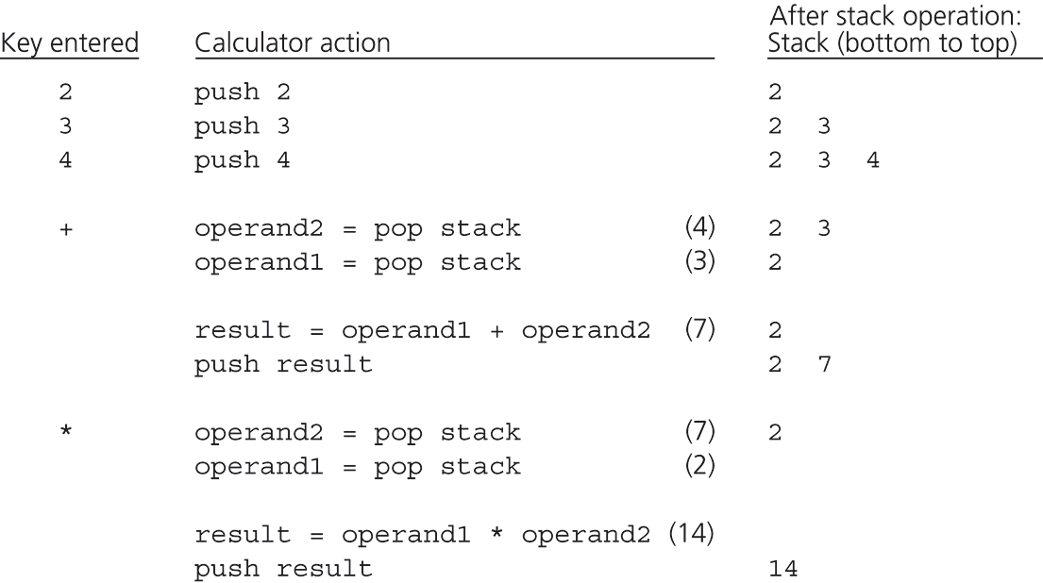
Evaluating Postfix Expressions – 2 3 4 + *
‹#›
Notes:
‹#›

Slide 48
Converting Infix Expressions to Postfix Expressions
An infix expression can be evaluated by first being converted into an equivalent postfix expression
Facts about converting from infix to postfix
  Operands always stay in the same order with respect to one another
  An operator will move only “to the right” with respect to the operands
  All parentheses are removed
‹#›
Notes:
‹#›

Slide 49
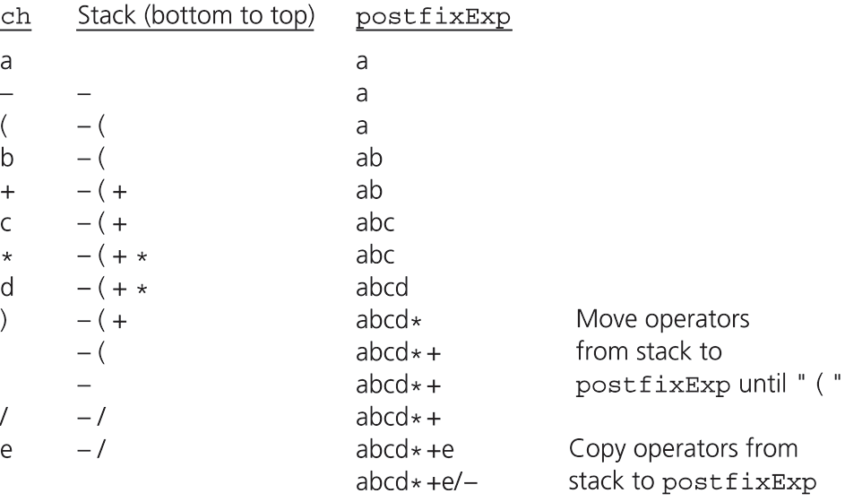
Converting Infix Expressions to Postfix Expressions
a - (b + c * d)/ e 🡺 a b c d * + e / -
‹#›
Notes:
‹#›

Slide 50
Converting Infix Expr. to Postfix Expr. -- Algorithm
for (each character ch in the infix expression) {
switch (ch) {
case operand: // append operand to end of postfixExpr
postfixExpr=postfixExpr+ch; break;
case ‘(‘: // save ‘(‘ on stack
aStack.push(ch); break;
case ‘)’: // pop stack until matching ‘(‘, and remove ‘(‘
while (top of stack is not ‘(‘) {
postfixExpr=postfixExpr+(top of stack); aStack.pop();
}
aStack.pop(); break;
‹#›
Notes:
‹#›

Slide 51
Converting Infix Expr. to Postfix Expr. -- Algorithm
case operator:
aStack.push(); break; // save new operator
} } // end of switch and for
// append the operators in the stack to postfixExpr
while (!isStack.isEmpty()) {
postfixExpr=postfixExpr+(top of stack);
aStack(pop);
}
‹#›
Notes:
‹#›

Slide 52
The Relationship Between Stacks and Recursion
A strong relationship exists between recursion and stacks
Typically, stacks are used by compilers to implement recursive methods
  During execution, each recursive call generates an activation record that is pushed onto a stack
  That's why we can get stack overflow error if a function makes makes too many recursive calls
Stacks can be used to implement a nonrecursive version of a recursive algorithm
‹#›
Notes:
‹#›

Slide 53
C++ Run-time Stack
The C++ run-time system keeps track of the chain of active functions with a stack
When a function is called, the run-time system pushes on the stack a frame containing
  Local variables and return value
When a function returns, its frame is popped from the stack and control is passed to the method on top of the stack
main() {
int i = 5;
foo(i);
}
foo(int j) {
int k;
k = j+1;
bar(k);
}
bar(int m) {
…
}
bar
m = 6
foo
j = 5
k = 6
main
i = 5
Run-time Stack
‹#›

Slide 54
Example: Factorial function
int fact(int n)
{
if (n ==0)
return (1);
else
return (n * fact(n-1));
}
‹#›
*

Slide 55
Tracing the call fact (3)
N = 0 if (N==0) true return (1)
N = 1 if (N==0) false return (1*fact(0))
N = 2 if (N==0) false return (2*fact(1))
N = 3 if (N==0) false return (3*fact(2))
After 3rd call
N = 3 if (N==0) false return (3*fact(2))
After original call
N = 2 if (N==0) false return (2*fact(1))
N = 3 if (N==0) false return (3*fact(2))
After 1st call
N = 1 if (N==0) false return (1*fact(0))
N = 2 if (N==0) false return (2*fact(1))
N = 3 if (N==0) false return (3*fact(2))
After 2nd call
‹#›
*

Slide 56
Tracing the call fact (3)
N = 1 if (N==0) false return (1* 1)
N = 2 if (N==0) false return (2*fact(1))
N = 3 if (N==0) false return (3*fact(2))
After return from 3rd call
N = 2 if (N==0) false return (2* 1)
N = 3 if (N==0) false return (3*fact(2))
After return from 2nd call
N = 3 if (N==0) false return (3* 2)
After return from 1st call
return 6
‹#›
*

Slide 57
Example: Reversing a string
void printReverse(const char* str)
{
????????
}
‹#›
Notes:
‹#›

Slide 58
Example: Reversing a string
void printReverse(const char* str)
{
if (*str) {
printReverse(str + 1)
cout << *str << endl;
}
}
‹#›
Notes:
‹#›

Slide 59
Example: Reversing a string
void printReverseStack(const char* str)
{
Stack<char> s;
for (int i = 0; str[i] != ’\0’; ++i)
s.push(str[i]);
while(!s.isEmpty()) {
char c;
s.topAndPop(c);
cout << c;
}
}
‹#›
Notes:
‹#›

Slide 60
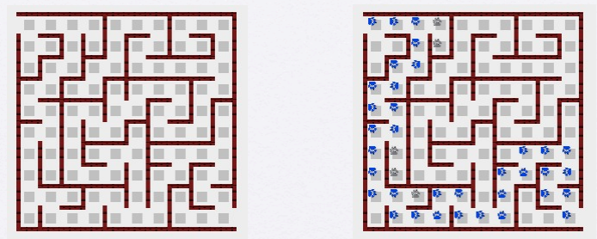
Example: Maze Solving
Find a path on the maze represented by 2D array
‹#›
Notes:
‹#›

Slide 61
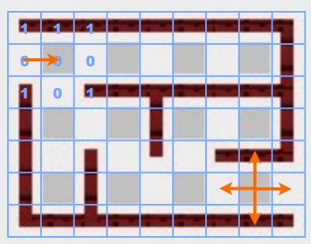
Example: Maze Solving
Find a path on the maze represented by 2D array
Push the traced points into a stack
‹#›
Notes:
‹#›

Slide 62
Example: Maze Solving
Find a path on the maze represented by 2D array
Move forward if possible. If not, pop until a new direction move is possible.
‹#›
Notes:
‹#›

Slide 63
Example: Integer to Binary
Binary to integer is easy; how about the reverse?
What is 232 in binary?
‹#›
Notes:
‹#›

Slide 64
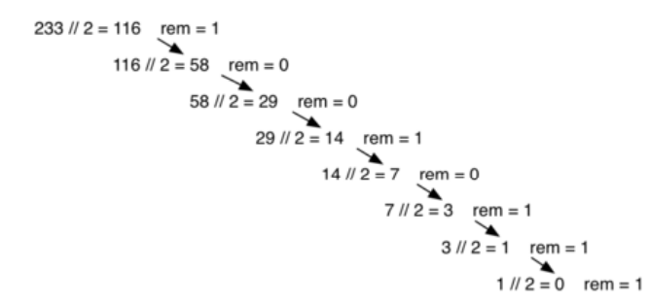
Example: Integer to Binary
Binary to integer is easy; how about the reverse?
What is 232 in binary?
‹#›
Notes:
‹#›

Slide 65
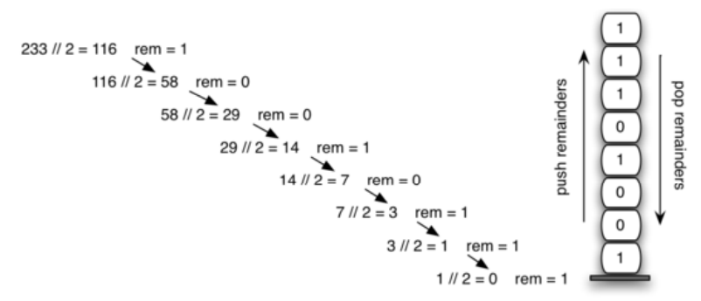
Example: Integer to Binary
Binary to integer is easy; how about the reverse?
What is 232 in binary?
‹#›
Notes:
‹#›

Slide 66
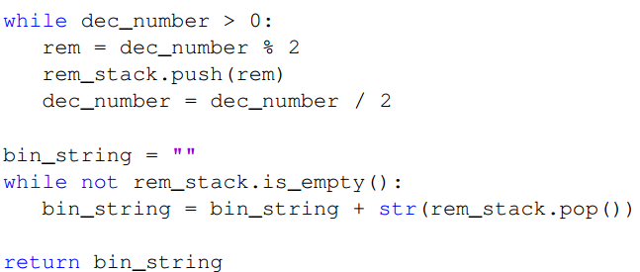
Example: Integer to Binary
Binary to integer is easy; how about the reverse?
What is 232 in binary?
‹#›
Notes:
‹#›

Slide 67
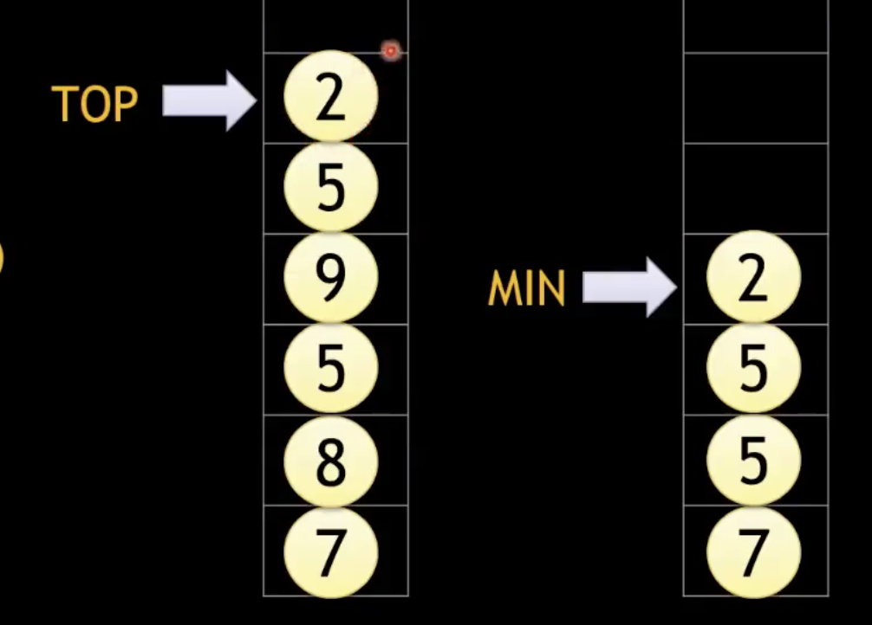
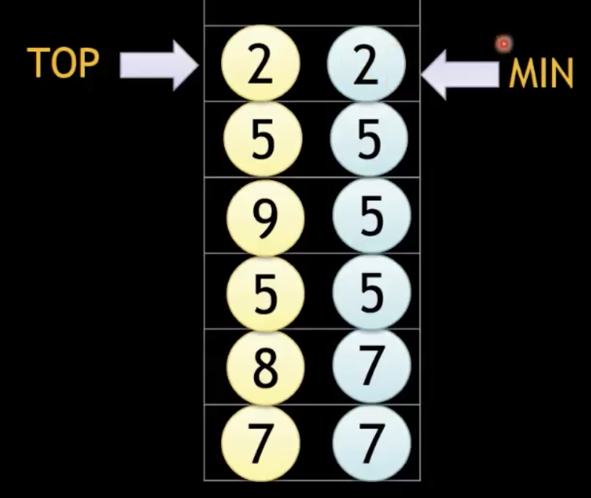
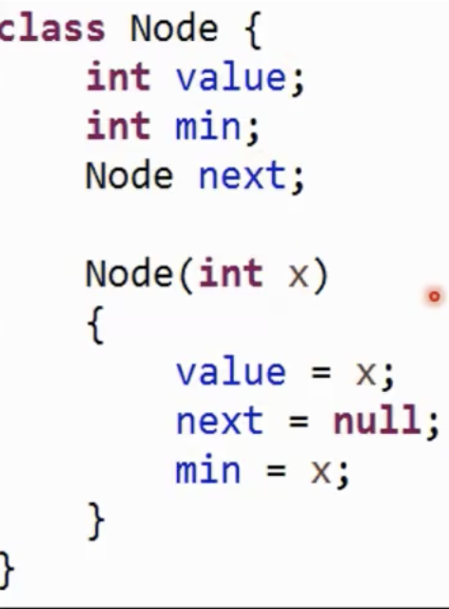
Example: Min Stack O(1)
Min, top, pop, push in O(1)
Maintaining a global Minimum variable fails; why? Hint: pops
Use a second Min stack
Or use a Minimum variable on each node
‹#›
Notes:
‹#›

Slide 68
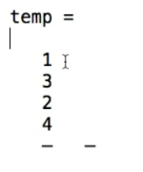
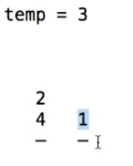
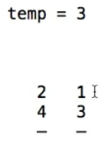
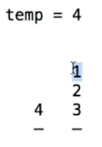
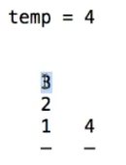
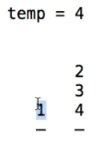
Example: Sort a Stack
Using no more than one additional stack
Put top to temp; check before moving temp to 2nd stack
        temp is not smaller than 1; so pop 1 to 1st stack, put 3 and, put 1 back into 2nd stack
  Finally:
‹#›
Notes:
‹#›

Slide 69
Example: Smart max difference
Max difference b/w two elements of a stack in O(n) time
An element can only be compared with the ones below it
S:
5
19
3
7
4
5
12
2
22
10
max = maxDiff = -INF;
while (! S.isEmpty()) {
S.topAndPop(v);
if (v > max) max = v;
else
maxDiff = (max-v > maxDiff ? max-v : maxDiff);
}
return maxDiff;
‹#›
Notes:
‹#›

